Slide 1
Instructional Framework
Overview

Slide 2
Our Plan Moving Forward
We will successfully advance our priorities and meet our goals as a district if we rely on a research-based, experience proven plan for improving instruction in every classroom.
Centered on:
What We Teach (Curriculum)
How We Teach (Lesson Structures)
Authentic Literacy
“These three things…a content rich curriculum, sound lessons, and purposeful reading, writing and talking… if even reasonably well-executed, would have more impact than all other initiatives combined….would wholly redefine what public schools can accomplish with children of every socioeconomic stratum.”
Schmoker, Focus, 2011.

Slide 3
What We Teach
“Curriculum may be the single largest factor that determines how many students in a school will learn.” (Marzano, 2003)
Fall 2017:
Began a renewed emphasis on getting our curriculum right
Math, K-12
ELA K-2 and pilot in 3-12
All other content areas focusing on incorporating text every day
We must decrease the variability of the quality of materials from room to room, school to school.
Started walk-throughs with the Instructional Practice Guide (IPG)
Tool focused on ensuring fidelity to implementation of high–quality instructional materials

Slide 4
How We Teach
“Effective teaching is not some complex combination of talent, technique, or long experience…anyone can immediately implement the most essential, common elements of good teaching with success—and get better at them with practice.” (Schmoker, 2011)
Identifying research-based, time-proven aspects of effective instruction
We must decrease the variability of the effectiveness of instruction from room to room, school to school.
Directly aligns with our curriculum work and complements the IPG indicators

Slide 5
Authentic Literacy
“The clearest differentiator in reading between students who are college ready and students who are not is the ability to comprehend complex texts.” (ACT, Reading Between the Lines, 2006)
Authentic literacy is purposeful reading, writing, and discussion about texts in order to build skills and knowledge.
Will be accomplished by the texts and tasks in the new ELA curriculum
Must be integrated into all other subjects (except math)
Literacy is the spine that holds all of this together.
Every person in our district is a reading teacher.
Unless you are a math teacher, your class should include one or multiple texts every single day.
Improving literacy is an educational issue, an economic issue, and a moral issue.

Slide 6
Instructional Framework
Starter
Engagement
Ending
HOW
WHAT
IPG
Core Action 1
Core Action 2
Core Action 3
IPG
Core Action 1
Core Action 2
Core Action 3
IPG
Core Action 1
Core Action 2
Core Action 3
Notes:
How do you interpret this slide?

Slide 7
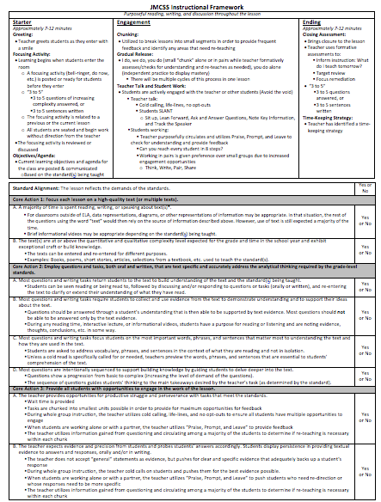
The “How”: Starter, Engagement, Ending
Measuring The “What”:
Core Actions 1, 2, and 3 of the IPG

Slide 8
IPG Walkthroughs
Core Action 1: Use of complex text
Core Action 2: Text-based tasks that meet the standards
Core Action 3: Fully engaging students with tasks
Majority of classrooms weren’t getting to Core Action 3
The key to student growth is meeting all 3
How do we effectively combine “what” we are teaching and “how” we are teaching?

Slide 9
The “How”
Starter, Engagement, Ending

Slide 11
Starter

Slide 12
Starter: Overview
Greeting
Focusing Activity
Objectives and Agenda

Slide 13
Greeting
Teacher greets students as they enter with a smile
Why?
Helps to build relationships
Communicates expectations as students enter the room
Identify any problems or difficult situations with individual students

Slide 14
Focusing Activity
Learning begins when students enter the room
A focusing activity (bell-ringer, do now, etc.) is posted or ready for students before they enter
“3 to 5”
3 to 5 questions of increasing complexity answered, or
3 to 5 sentences written
The focusing activity is related to a previous or the current lesson
All students are seated and begin work without direction from the teacher
The focusing activity is reviewed or discussed
Why?
Maximize the use of instructional time (bell-to-bell instruction)
Communicates a sense of urgency
Helps students to transition seamlessly from the hallway and builds positive behaviors and constructive habits by teaching students to transition from “hallway state” to ”learning state”
Reduces variables in a student’s day (students know what is expected of them)
Reduce classroom management issues and enhance relationships by reducing non-positive interactions (“nagging” them to get started) between teachers and students

Slide 15
Objectives and Agenda
Current learning objectives and agenda for the class are posted & communicated
Based on the standard(s) being taught
Why?
Define the major “chunks” of your lesson
Students are able to identify the “what” of the lesson
Students know where the class is headed and perceive a structured environment with expectations
Structure fosters a sense of safety and security

Slide 16
Starter: Recap
Greeting
Focusing Activity
Objectives and Agenda

Slide 17
Engagement

Slide 18
Engagement: Overview
Chunking
Gradual Release
Teacher Talk and Student Work

Slide 19
Chunking
Utilized to break lessons into small segments in order to provide frequent feedback and identify any areas that need re-teaching
Why?
“Big” chunks/segments of the lesson are organized around your learning objectives and agenda
Ensures each portion of the lesson is manageable and not too long
Allows you to formatively assess each chunk/segment/objective

Slide 20
Gradual Release
This process is within a single “chunk” or segment of the lesson
I do
We do
You do (small “chunk” alone or in pairs while teacher formatively assesses/checks for understanding and re-teaches as needed)
You do alone (independent practice to display mastery)
There will be multiple cycles of this process in one lesson
Why?
Opportunity for modeling
Allows you to get immediate feedback
Before fully releasing students to the full task, you can test out a “small chunk”
By actively engaging students, teachers create “a feedback loop that allows you to spot errors as they occur and correct them.”—Daniel Goleman

Slide 21
Teacher Talk and Student Work
During all parts of the lesson (each chunk), one of two things is happening…the teacher is talking or students are working:
Students are actively engaged with the teacher or other students (Avoid the void)
Teacher Talk:
Cold calling, life-lines, no opt-outs
Students SLANT
Sit up, Lean Forward, Ask and Answer Questions, Note Key Information, and Track the Speaker
Students Working:
Teacher purposefully circulates and utilizes Praise, Prompt, and Leave to check for understanding and provide feedback
Can you reach every student in 8 steps?
Working in pairs is given preference over small groups due to increased engagement opportunities
Think, Write, Pair, Share
No Teacher “SAD” (Sitting at Desk)
Why?
There is a purpose to all parts of the lesson. You communicate that by questioning/checking.
“The brain that does the work does the learning.” –David C. Sousa
Increased student engagement and opportunities to respond relate to increased academic achievement, increased on-task behavior, and decreased behavioral challenges. –Anita Archer
When a vacuum exists negativity will enter. “Avoid the void.” –Anita Archer

Slide 22
Engagement: Recap
Chunking
Gradual Release
Teacher Talk and Student Work

Slide 23
Ending

Slide 24
Ending: Overview
Closing Assessment
Time-Keeping Strategy

Slide 25
Closing Assessment
Brings closure to the lesson
Teacher uses formative assessments to:
Inform instruction: What do I teach tomorrow?
Target review: What do I need to reteach?
Focus remediation/enrichment: Which students need remediation or enrichment?
“3 to 5”
3 to 5 questions answered, or 3 to 5 sentences written to determine if students mastered the objectives communicated at the beginning of the lesson
Why?
Provides feedback to the teacher– did you teach what you intended to teach and have the students learned what you intended them to learn?
Assess progress on the objectives you set at the beginning of the lesson
Reduces forgetting and improves retention long-term memory by up to 50 percent
Opportunity to reinforce the key concepts/ideas within the lesson
Opportunity for students to reflect and draw conclusions
Leads to higher-order thinking
Creates an opportunity to smoothly transition from one lesson to the next lesson

Slide 26
Time-Keeping Strategy
Teacher has identified a time-keeping strategy
Why?
One less thing to think about!
Make sure you build in time for your closing assessment
Ensure mastery is assessed

Slide 27
Ending: Recap
Closing Assessment
Time-Keeping Strategy

Slide 28
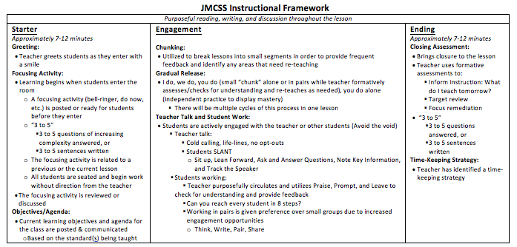

Slide 29
Combining the “What” and the “How”

Slide 30
Combining the “What” and “How”
The components of “Starter, Engagement, and Ending” (S-E-E) work together with the IPG Core Actions to complete our Instructional Framework.
The “How” and the “What”
Moving forward, this is our Instructional Framework!

Slide 31
Walk-through at the beginning of your class…
The Starter would be the focus, along with the 3 Core Actions of the IPG
1
2
3

Slide 32
Walk-through in the middle of your class…
Engagement would be the focus, along with the 3 Core Actions of the IPG
1
2
3

Slide 33
Walk-through at the end of your class…
The Ending would be the focus, along with the 3 Core Actions of the IPG
1
2
3

Slide 34
The “How”: Starter, Engagement, Ending
What kind of feedback will I get?
You’ll receive feedback on the “how” and the “what”
Depending on which point in the lesson is seen during the walk-through, you’ll get a piece of feedback on a component from the Starter/Engagement/Ending section.
You’ll also get a piece of feedback on how far your lesson progressed on the IPG
Measuring The “What”:
Core Actions 1, 2, and 3 of the IPG

Slide 35
What kind of feedback will I get?
Example scenario:
A walk-through happens at the beginning of a class. The focusing activity consists of 3 questions about a text the class read yesterday and the lesson jumps immediately from the focusing activity to a time of direct instruction.
A walk-through will receive 2 pieces of feedback…one on the “how” and one on the “what”:
Feedback on the “How”: Emphasizing the importance of taking a couple of minutes to communicate the lesson’s objectives and a basic agenda for the the class.
Feedback on the ”What”: Most of the questions from the focusing activity can be answered without any evidence from the text, so Core Action 2, Indicator B is identified as a place to strengthen.

Slide 36
Example of a blank feedback form for a coaching conversation

Slide 37
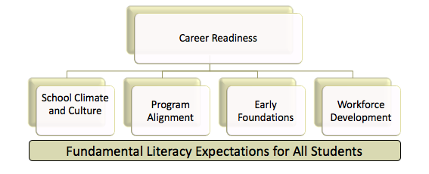
Working Our Plan
By improving our “what” and our “how” while
emphasizing literacy in all areas, we will meet our goals.
This is it.
We must pursue these and not compromise their simplicity, clarity, and focus.

